Slide 1


Credit Card Billing and Payment Reminder System
NAME : HEMA HARSHITHA V
REGISTER NUMBER : 25BCS219
DEPARTMENT : B.Sc.COMPUTER SCIENCE
SUBJECT : JAVA PROGRAMMING

Slide 2

Introduction
The Credit Card Billing and Payment Reminder System is a software application designed to help users manage their credit card bills efficiently. It tracks billing dates, due dates, and outstanding balances, and sends timely reminders to avoid late payments. This system reduces the risk of penalties, improves financial discipline, and ensures smooth credit management.

Slide 3

PROBLEM STATEMENT:
1.Late payment fees
2.Increased interest charges
3.Poor credit scores
4.Financial mismanagement.

Slide 4
OBJECTIVES OF THE PROJECT
1.To store and manage credit card details securely
2.To track billing cycles and due dates
3.To send timely reminders for bill payments
4.To avoid late payment penalties
5.To provide a simple and user-friendly interface
6.To improve financial awareness and discipline

Slide 5
SCOPE OF THE SYSTEM
1.Used by individual credit card users
2.Tracks multiple credit cards
3.Sends alerts via system notification
4.Stores transaction and billing details
Can be extended to mobile apps or web-based systems

Slide 6
SYSTEM MODULES
Account & Billing Module– Manages customer/card data, generates statements, and calculates dues with interest.
Payment & Notification Module– Processes payments and sends reminders/alerts for due and overdue bills.

Slide 7
SYSTEM WORKFLOW
Transactions are recorded and compiled during the billing cycle.
System generates the credit card statement with total due and due date.
Reminders are sent to customers before and on the due date. Payment is processed if delayed, late fees are applied and alerts are sent.

Slide 8
JAVA CONCEPTS USED
Classes and Objects (User, Card, Transaction)
Encapsulation (private data with getters/setters)
Inheritance (optional for extending features)
Collections (ArrayList for storing data)
Exception Handling (invalid inputs)
File Handling / Database Connectivity (data storage)
Date and Time API (for reminders)

Slide 9
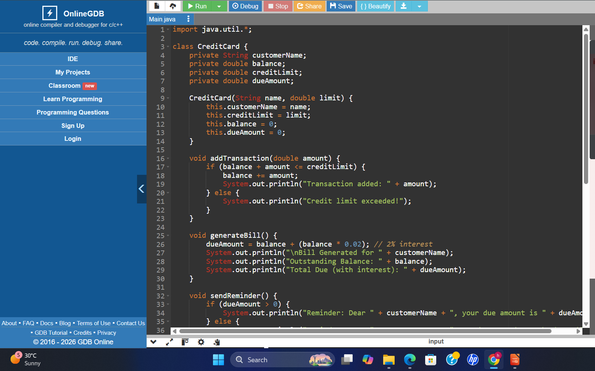
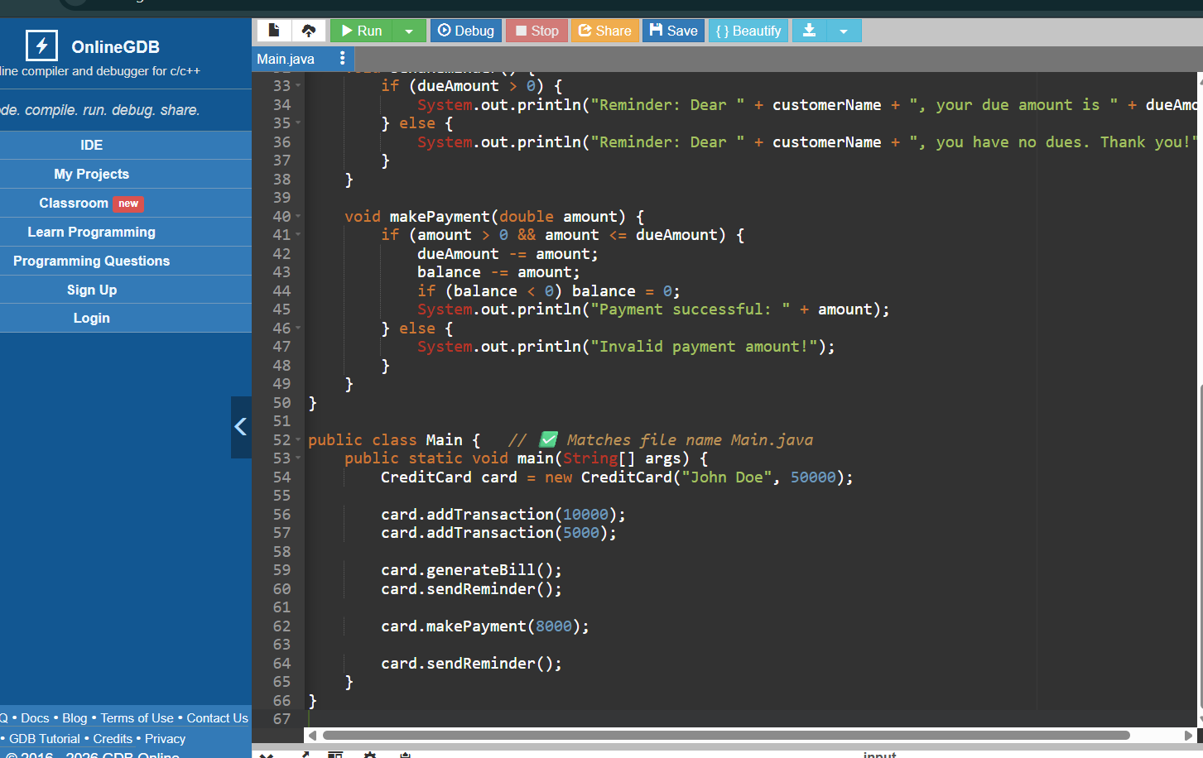
JAVA PROGRAM

Slide 10
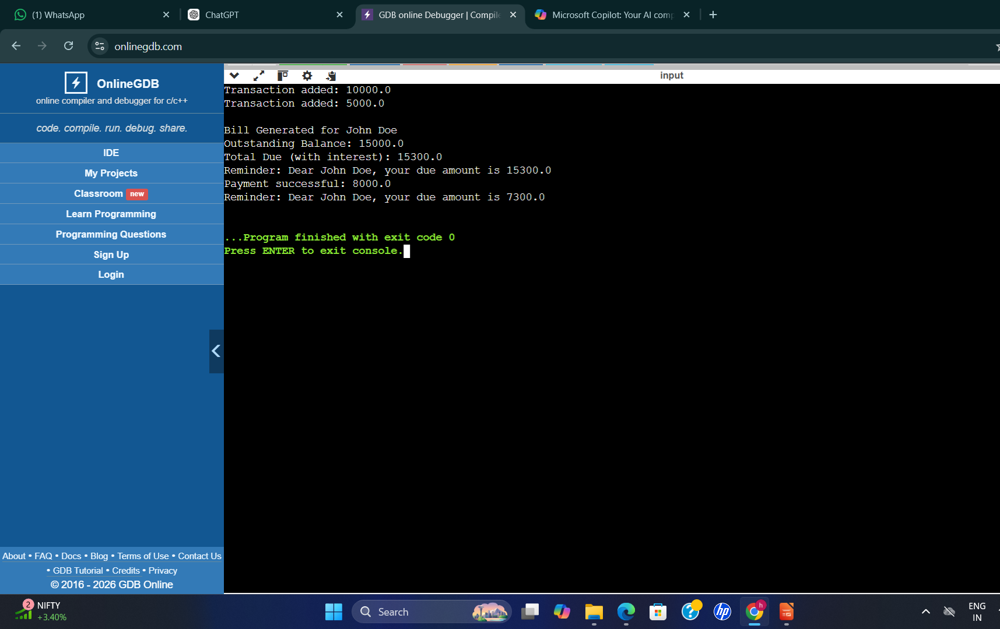
OUTPUT SCREEN

Slide 11

DEMONSTRATION STEPS
1.Create a credit card account and set the credit limit.
2. Add transactions to update the balance during the billing cycle.
3.Generate the bill and send payment reminders to the customer.
4.Process payment and update the remaining due or apply late fees if unpaid.

Slide 12
CONCLUSION
The Credit Card Billing and Payment Reminder System streamlines the management of credit card accounts by automating transaction tracking, bill generation, and payment reminders. It helps customers stay informed about their dues, reduces late payments, and improves financial discipline. For banks and financial institutions, it ensures accurate billing, timely collection, and enhanced customer satisfaction through efficient notifications. Overall, it enhances convenience, transparency, and reliability in credit card management.

Slide 13
REFERENCE
Herbert Schildt, Java: The Complete Reference, McGraw-Hill, 2021 – Covers Java programming concepts applicable to billing systems.
Budi Kurniawan, Java 8 for Programmers, Pustaka Digital, 2019 – Demonstrates practical Java applications including transaction and payment processing.

